Slide 1
Course : COMP8029 – IT Security and Risk Management
Period : September / February 20XX
Enrichment – Lab: IT Security
Session 06
KDS – Name SME

Slide 2
Enumeration
Enumerate username using Null Session
Cracking Password
Adding user account remotely
Tools: Net MS-DOS Command line, Hydra 5.4, dan Cain & Abel.

Slide 3
SQL Injection
SQL Injection (SQLi) refers to an injection attack wherein an attacker can execute malicious SQL statements (also commonly referred to as a malicious payload) that control a web application’s database server (also commonly referred to as a Relational Database Management System – RDBMS). Since an SQL Injection vulnerability could possibly affect any website or web application that makes use of an SQL-based database, the vulnerability is one of the oldest, most prevalent and most dangerous of web application vulnerabilities.
By leveraging an SQL Injection vulnerability, given the right circumstances, an attacker can use it to bypass a web application’s authentication and authorization mechanisms and retrieve the contents of an entire database. SQL Injection can also be used to add, modify and delete records in a database, affecting data integrity.
To such an extent, SQL Injection can provide an attacker with unauthorized access to sensitive data including, customer data, personally identifiable information (PII), trade secrets, intellectual property and other sensitive information.
From acunetic.com

Slide 4
Challenges of Security
Injection
Broken Authentication and Session Management
Cross-site Scripting
Insecure Direct Object References
Security Misconfiguration
Sensitive Data Exposure
Missing Function Level Access Control
Cross-site Request Forgery (CSRF)
Using Components with Known Vulnerabilities
Unvalidated Redirects and Forwards

Slide 5
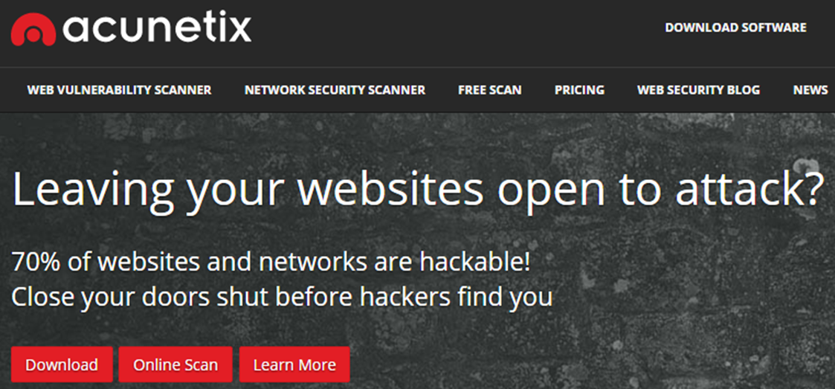
Challenges of Security
From http://www.acunetix.com/
28 December 2016
Bina Nusantara University

Slide 6
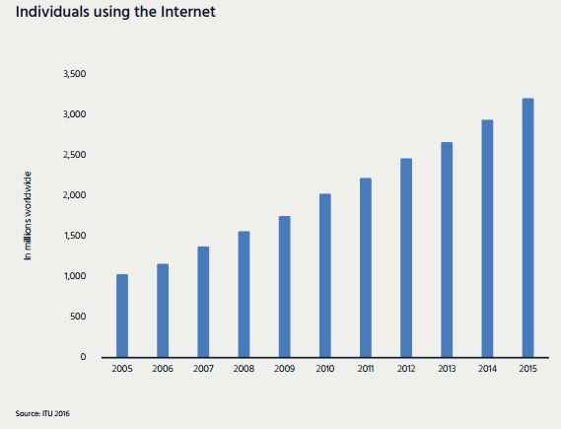
Challenges of Security
According to the ITU, the Internet passed the 3 billion user milestone in 2015, with just over 3.2 billion users worldwide by the end of the year.
Bina Nusantara University

Slide 7
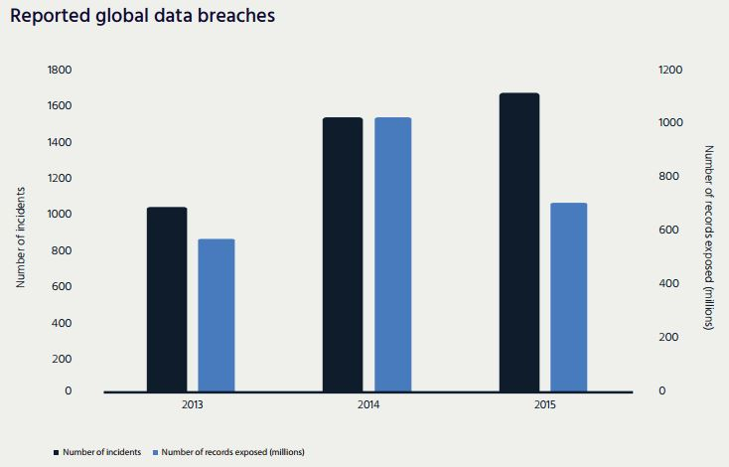
Gemalto (internet society – Global Internet Report 2016) reported 1,673 known incidents for 2015, with 707 million records known to be exposed.
Bina Nusantara University

Slide 8
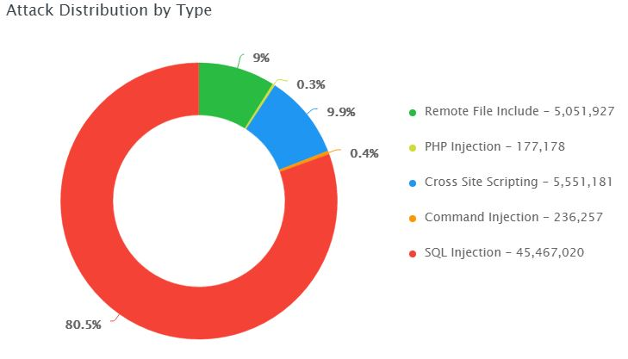
From akamai.com - 28 December 2016
Bina Nusantara University

Slide 9
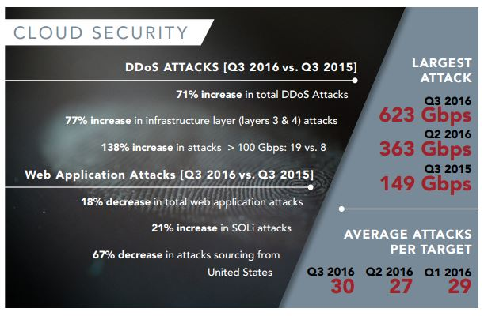
From akamai.com - 28 December 2016
Bina Nusantara University

